Slide 1
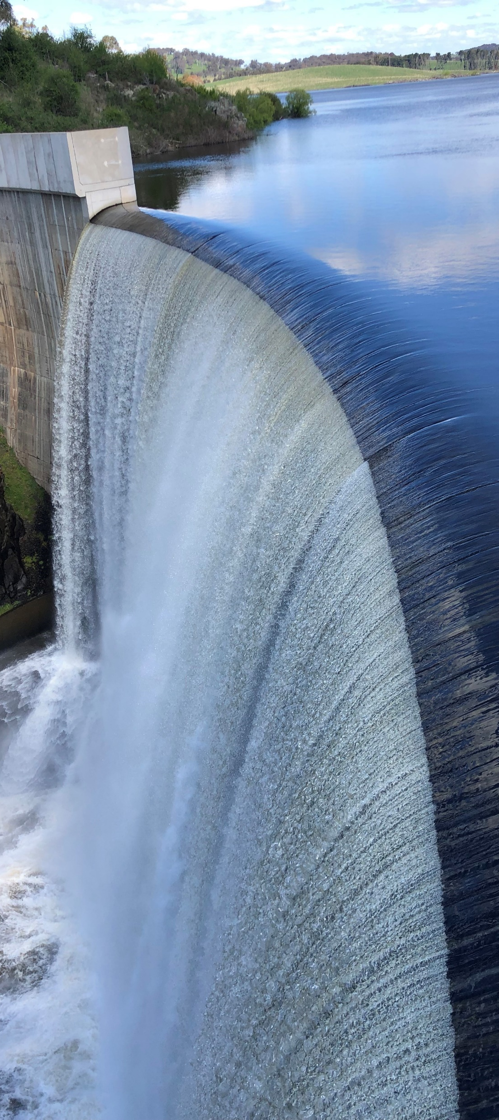
Dams Safety NSW
Consultants’ forum
Duration 1hr 35m
August 2023

Slide 2

Notes:
Before we begin, I’d like to acknowledge the traditional custodians of the many lands from which we’re joining the forum today, and pay my respects to elders past, present and emerging

Slide 3
Welcome
1
Margaret Hynes, Capability Manager, Dams Safety NSW
Notes:
Paul intro
MH to cover housekeeping items including emergency evacuation

Slide 4
Introduction
2
Chris Salkovic – Chief Executive Officer, Dams Safety NSW

Slide 5
Competent persons
Competent person - defined under clause 3 of Dams Safety Regulation 2019
  Clause 15 – Assessment of societal and individual risk
  Clause 20 – Safety review.

Slide 6
Risk report compliance
3
Jason Porter – Principal Engineer, Dams Safety NSW

Slide 7
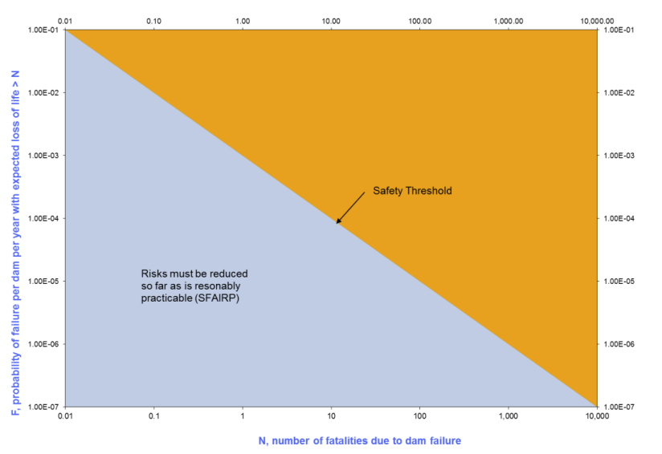
What’s the big picture?
Safe dams in NSW – a better understanding of risk.
To inform a SFAIRP decision by the dam owner…..therefore only need to as much analysis to help owner make decision, i.e. cost effective risk analysis.
?

Slide 8
Risk report review – DSNSW process
Owners send risk reports to us at info@damsafety.nsw.gov.au (if above ST or if we ask)
Triaged by Operations Team (does it have a competent person declaration by writer and peer reviewer?)
Engineering team do a high level check for evidence that essential elements, i.e., that the ‘must’ statements in the regulation and methodology are addressed
We will respond to owner within 30 days – hopefully you won’t need to do rework!

Slide 9
What are the relevant regulatory tools?
1. Dams Safety Regulation, 2019
  Clause 14 Risk management framework
  Clause 15 Assessment of societal and individual risk rating.
2. Societal and Individual Risk Rating Methodology published in the Government Gazette of NSW No. 133 of 18 March 2022
  Check you are using the most recent from website
  We look at the “must” requirements in these clauses.
  We also look at the “should” and “may” to ensure sound methods are used where judgement is allowed.

Slide 10
What about the reports not sent to us?
The first tranche of around 75 reports was due by December 2022. We expected risk reports with societal risk rating plotting above the safety threshold to come to us from mid-2022 to January 2023.
In addition to the requirements of Cl.15(4), it is possible that an owner does a risk report and thinks their dam is not above any of these thresholds… we will capture this in two ways…
  All reports must be available at the discovery stage of any audit
  From January each year we will request a sample of the reports not sent to us.

Slide 11
Sampling
“Dear [Dam Owner],
Dams Safety NSW earlier advised a written risk report must be produced for xxxxxxx Dam, by 31 December 2022. This is a requirement under clause 15 of Dams Safety Regulation 2019.
… please send a copy of this report … by no later than 21 April 2023.
Alternatively please indicate a reason, from the options below, for not completing the risk report by the due date and advise by return email… ”
In January 2023 we requested ALL the Extreme CC dams due in December 2022
… and were concerned with the poor response
in April 2023 we asked for ALL the December 2022 tranche to be sent to us.

Slide 12
Feedback from DSNSW
Snap sample of 31 risk reports that were actually risk reports:
  Extreme, High A, High B, High C (and one Significant…)
  Water dams, tailings dams and detention basins
  SOCs, Councils, Mines, Private water supplies.
Compliance checked against regulation and methodology:
  Risk reports to be done by a competent person and if required, independently peer reviewed by a competent person
  The “must” statements of Clause 15 and the methodology – minimum screening accepted by DSNSW Board.

Slide 13
Feedback from dam owners
Not aware of requirement to complete the risk report
Difficulty finding suitable professional services to complete the work in time
Started engagement of professional services too late
Work more complex than originally thought (taking longer to complete the work)
Needed guidance on where to start.

Slide 14
?

Slide 15
Help !
DSNSW resources
Dam Safety Facts - Risk reports for declared dams | Dams Safety (nsw.gov.au)
Guideline - Dam safety management system | Dams Safety (nsw.gov.au) – explanation of Clause 15 and the requirement for risk reports
ANCOLD resources, others ????

Slide 16
Clause 14 is powerful
The recommendations of a risk report will contain a detailed plan of action for the owner (“Risk Treatment” is essential per Clause 14)
This plan should lay out the necessary steps for
  prioritised mitigation of known risks or
  improving their understanding of the probabilities involved
The most crucial aspect of this plan is that it includes specific timeframes
It will in turn be a plan that we as a regulator can hold owners to account.

Slide 17
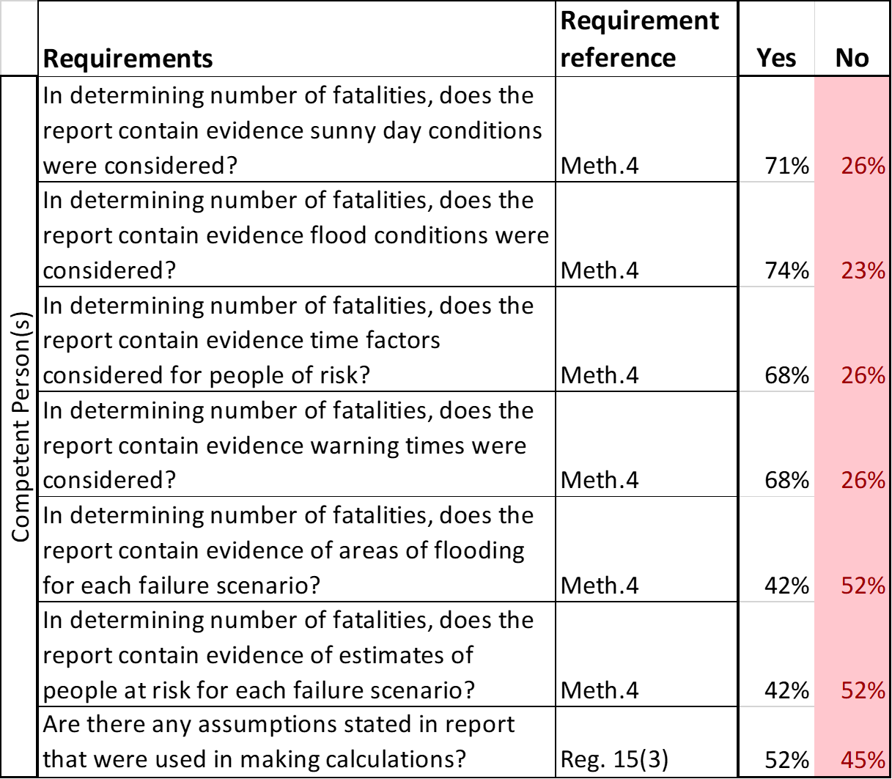
Refer to the Regulation
Refer to the Methodologies
Does the report contain evidence of …
Are there any assumptions stated?

Slide 18
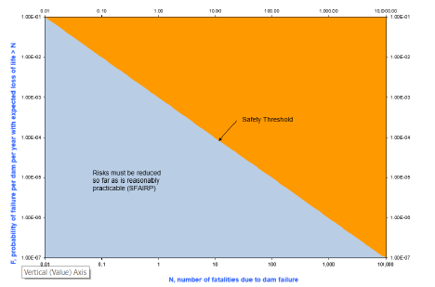
Uncertainties… Clarity…
Scarce information –> large uncertainties –> you must document your assumptions
Document assumptions
At the conclusion of the risk assessment process, prepare a very clear action plan for owner so those uncertainties can be reduced – reference to Clause 14.

Slide 19
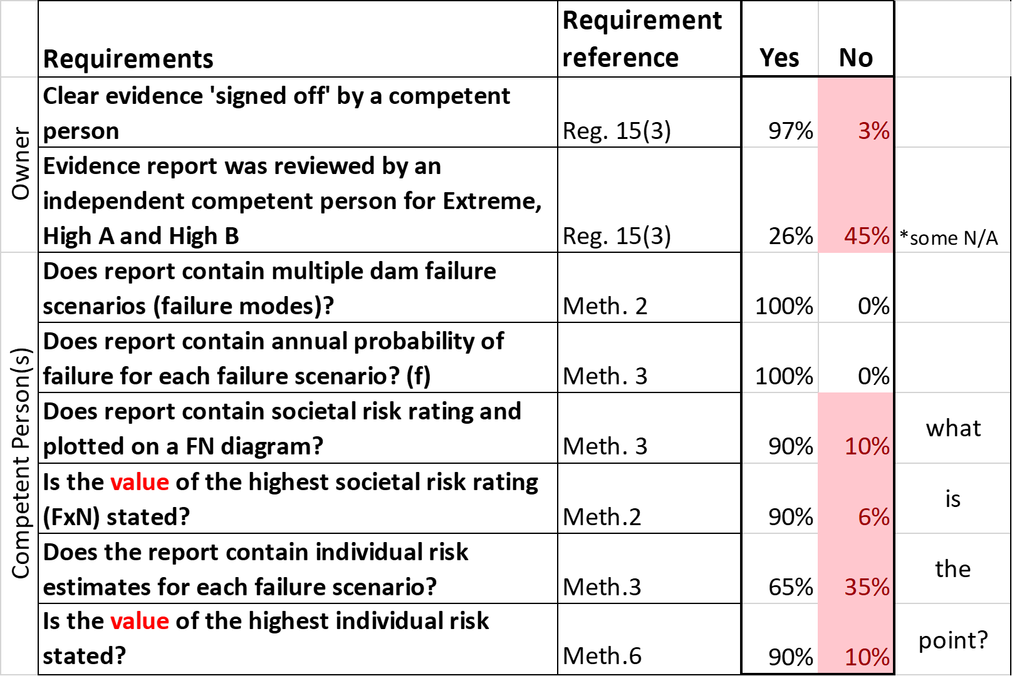

Slide 20
?

Slide 21
Assumptions… Uncertainties…
Even a screening level assessment can be quantitative
As soon as the owner thinks the societal risk rating is above the safety threshold, tell DSNSW
Draft / Interim / etc - these words mean nothing to us as a regulator and they do not feature in our regulatory framework
We accept risk reports have the best available information within them, at the time the report is produced.

Slide 22
SFAIRP assessment
4
Peter Boyd – Governance & Assurance Manager, Dams Safety NSW

Slide 23
Dams Safety Regulation 2019
15 Assessment of societal and individual risk rating
(1) The owner of a declared dam (other than a proposed dam) must use the risk management framework under clause 14 to produce a written report on all foreseeable risks to the dam –
(a) at least once every 5 years,
(3) In preparing a report under this clause, the dam owner must also set out in the report -
(a) the societal risk rating and the highest individual risk rating of the dam -
      calculated in accordance with the Societal and Individual Risk Rating Methodology published in Gazette No 113 of 18 March 2022,

Slide 24
Dams Safety Regulation 2019
Societal risk rating
for an existing dam -
0.001

Slide 25
Dams Safety Regulation 2019
15 Assessment of societal and individual risk rating
(4) If the societal risk rating or highest individual risk rating for a dam is higher than the following (the safety threshold), the dam owner must forward a copy of the report to Dams Safety NSW as soon as practicable after the report is produced -
(a) societal risk rating for an existing dam (except as provided by paragraph (b)) - 0.001,
(b) societal risk rating for a proposed dam or for an existing dam that is to be subject to a major augmentation - 0.0001,
(c) individual risk rating for an existing or proposed dam - 0.0001.

Slide 26
Dams Safety Regulation 2019
Societal risk rating
for an existing dam -
0.001

Slide 27
Dams Safety Regulation 2019
14 Risk management framework
(6) The risk treatment process must identify risk reduction measures that are to be implemented to eliminate or reduce risks, but only in so far as is reasonably practicable.

Slide 28
Most important consideration
Risk reduction measures are to be implemented so far as is reasonably practicable (SFAIRP)
Regardless of the dam risk rating, even if it is above the safety threshold.

Slide 29
Dams Safety Regulation 2019
14 Risk management framework
(7) In determining whether it is reasonably practicable to implement a risk reduction measure, a cost benefit analysis may be carried out taking into account all relevant matters including the following -
    (a) the likelihood of the risk occurring
    (b) the degree of harm that may result from the risk
    (c) the availability and suitability of the relevant risk reduction measure
    (d) the cost of the relevant risk reduction measure.

Slide 30
Dams Safety Regulation 2019
15 Assessment of societal and individual risk rating
(4) If the societal risk rating or highest individual risk rating for a dam is higher than the following (the safety threshold), the dam owner must forward a copy of the report to Dams Safety NSW as soon as practicable after the report is produced -
(a) societal risk rating for an existing dam (except as provided by paragraph (b)) - 0.001,
(b) societal risk rating for a proposed dam or for an existing dam that is to be subject to a major augmentation - 0.0001,
(c) individual risk rating for an existing or proposed dam - 0.0001.
(5) Dams Safety NSW may direct the owner of a dam for which the societal risk rating or highest individual risk rating is above the safety threshold to take specific steps within a specified time to ensure that the rating is reduced to the safety threshold or lower.

Slide 31
Q&A
5
Margaret Hynes, Capability Manager, Dams Safety NSW

