Slide 1
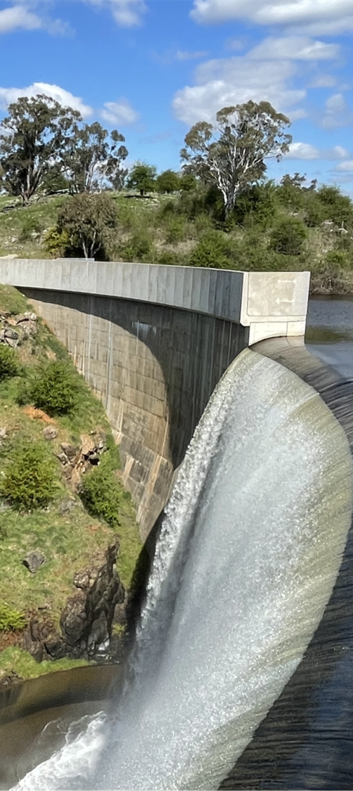
Emergency plans and the NSW SES: New requirements
Department of Climate Change, Energy, the Environment and Water (DCCEEW)
NSW State Emergency Service (NSW SES)
Online Forum
Jason Porter, Peter Boyd (Dams Safety NSW)
Sam Cantwell, Craig Ronan (NSW SES)
20 March 2024

Slide 2
The Australian Warning System
There are three levels of warning within the Australian Warning System (AWS):
Advice - there is a heightened level of threat. Stay up to date as the situation changes.
Watch and Act - conditions are changing and you need to start taking action now to protect you and your family.
Emergency Warning - the highest level of warning. You may be in danger and need to take action immediately.

Slide 3
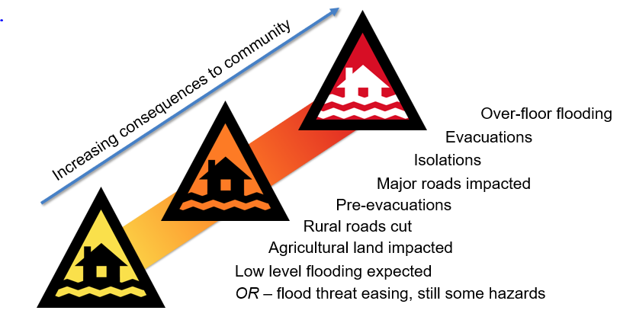

Slide 4
Three core components
+
+
The type of hazard impacting the community and the location (eg Boorowa flooding).
An action statement/s to guide protective action by the community, evolving as the warning levels increase in severity. (eg ‘prepare to evacuate’).
The maturity of the natural hazard event and whether/what specific actions are required of the community.

Slide 5
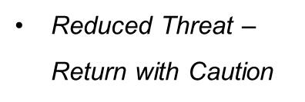

Slide 6
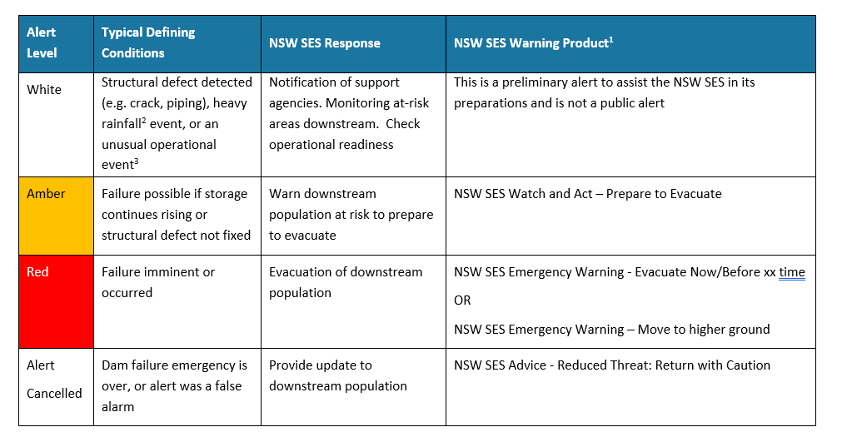
Alert triggers
UPDATED
Typical dam failure alert protocols
Notes:
Updated table notes new warning products that reflect the new AWS messaging
“Alert Cancelled” level added to the table to emphasise notification required when an emergency is over, to enable SES to provide updates to downstream communities if required – previous messaging was “All Clear”
Caveat added to clarify that warning products will be issued appropriate to the circumstances
“This is a ‘typical’ NSW SES warning response [product], however the issuance, or not, of any warning product will be dependent on a risk assessment and the response strategy chosen at the time”

Slide 7
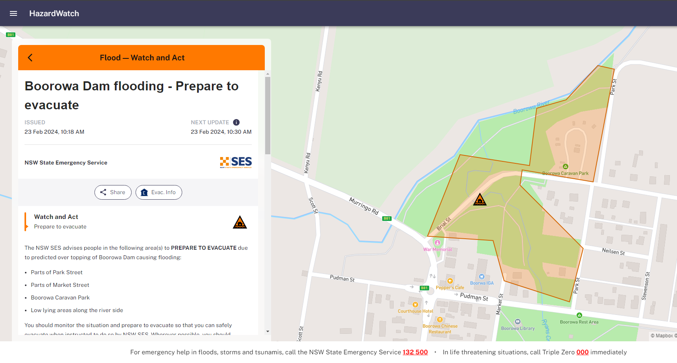

Slide 8
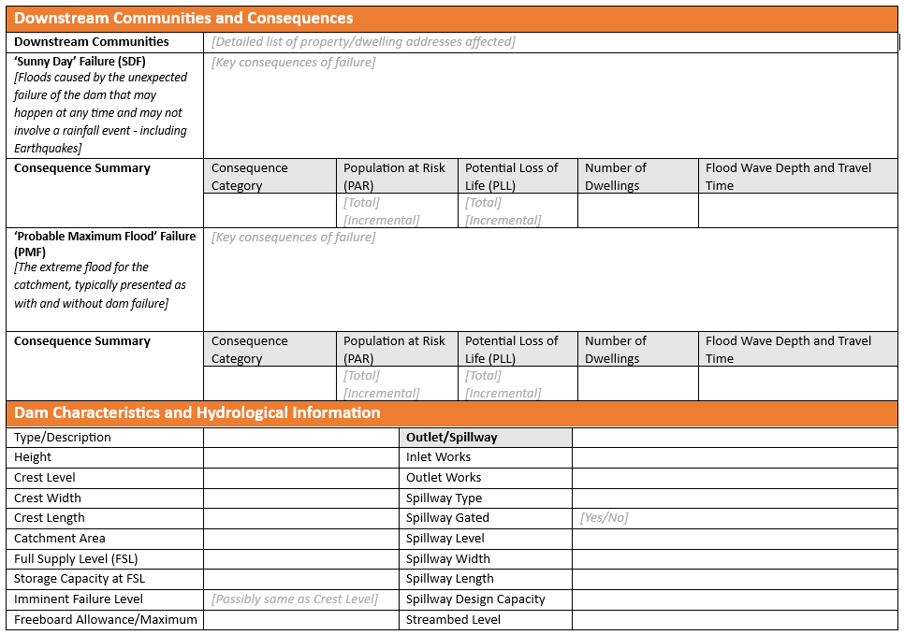
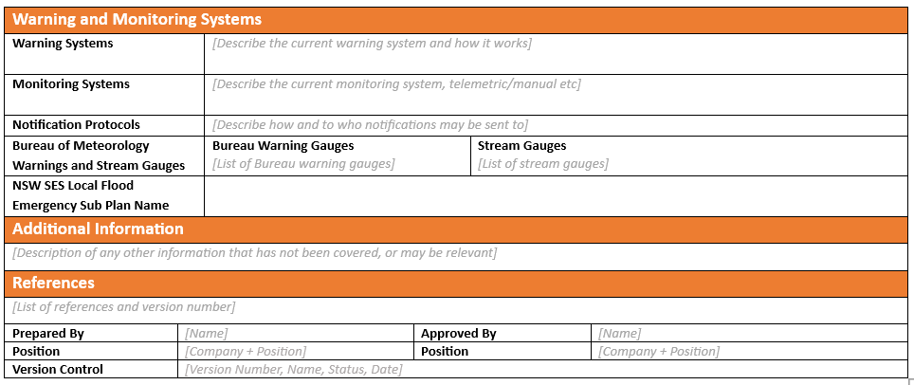
NSW SES Dam Summary sheet

Slide 9
NSW SES Dam Summary sheet

Slide 10
NSW SES Dam Summary sheet

Slide 11
NSW SES Dam Summary sheet

Slide 12
Questions?
For all enquiries to NSW SES, please contact nswses.communityplanning@ses.nsw.gov.au
For all enquires to Dams Safety NSW, please contact
info@damsafety.nsw.gov.au or visit our website
https://www.damsafety.nsw.gov.au

